Slide 1


Summary
Steering Committee Meeting
25 September 2007
PRAGMA 13 @ NCSA
PRAGMA Engagements in Cyberinfrastructure
Notes:
Institute for Advanced Computing Applications and Technologies (IACAT)

Slide 2


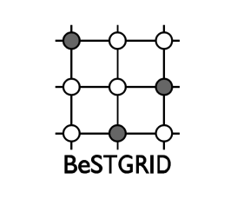
New Members
Monash University
CSE Online
BeSTGRID
Welcome

Slide 3




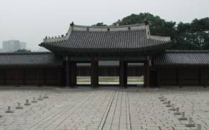

PRAGMA Meetings of the Future
PRAGMA 14
  NCHC, Taiwan
  10 – 12 March 2008; Tutorial 10 March (Monday), Tour Thursday and Friday 13-14 March 2008
PRAGMA 15
  USM, Malaysia
  22 – 24 October 2008 (with other activities)
PRAGMA 16
  KISTI, Daejon, Korea
  March 2009

Slide 4
Posters and Demos
Will do Posters Again –
  Try to have time during day set aside for this
Demos –
  Pleased with tighter connection with Working Groups
  Pleased that they were in fact demos

Slide 5
Second PRAGMA Institute
Accepted proposal by NCHC to host second PRAGMA Institute
Theme: Advanced Technologies Institute with Trust and Diversity
Held in conjunction with Southeast Asia International Joint Research and Training Program
Dates: 3 – 7 December 2007,
Location: Hsinchu

Slide 6
PRAGMA and Industry
New model: Sponsor and Targeted Affiliate
Establish at Subcommittee to determine a way to actively implement a program

Slide 7
Joint Summit in Switzerland
Need to be plugged into activities around the world
New opportunity to build bridges to new Swiss Grid, and new activities in European Grid
And continue ties with a very activity participant
Plan to co-host meeting in Switzerland

Slide 8
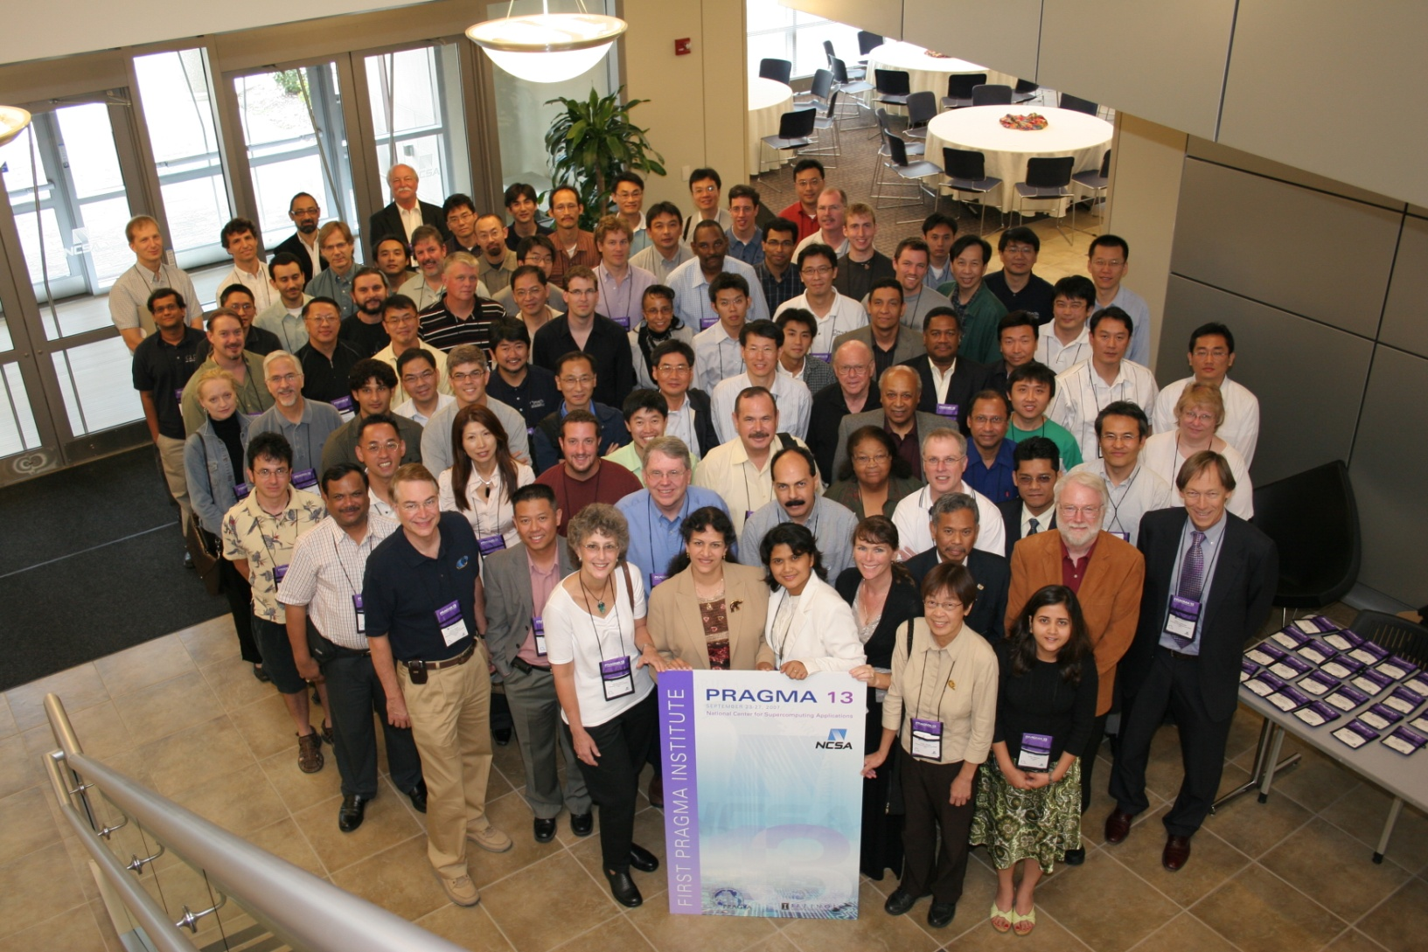
NCSA and IACAT, Thank you for hosting us

